Slide 1
Truck Fleet Risk Analytics and Driver Safety Solutions
Group #1:
Sara Crowe
Shreevershith Kollabettu
Annastacia Marchand
Angela Reynolds
Prasanth Chowdary Yanamandala

Slide 2
Problem Statement and Objectives
Az National Trucking (ANT) faces significant insurance risks due to non-compliance with safe driving practices among its fleet drivers. Ensuring strict adherence to the company's safety regulations is critical to mitigating these risks and maintaining the company's reputation and financial stability.
Utilize telematics and GPS tracking to monitor driving behavior and provide real-time feedback to drivers.
Identify and address key factors contributing to insurance risks, such as speeding, unsafe following, and lane departure.
Regularly review and analyze incident reports to identify trends and areas for improvement.

Slide 3
Business Questions
What are the cities with the most unsafe events?
Provides insight into geographic trends, enabling targeted review for conditions in the city
What are the most uncommon unsafe behaviors?
Provides guidance to improve training, additional safety measures within the industry
What is the proportion of risky drivers to safe?
Provides perspective on success of current safety initiatives, overall risk to the company based on current driver trends
Who in our drivers has the highest risk score (or the lowest)?
Allows for targeted performance review for both negative (risky) behavior and positive (safe) behavior
Among risky drivers, which unsafe events are most common?
Allows for targeted training and potentially predictive models to identify drivers before they are considered risky

Slide 4
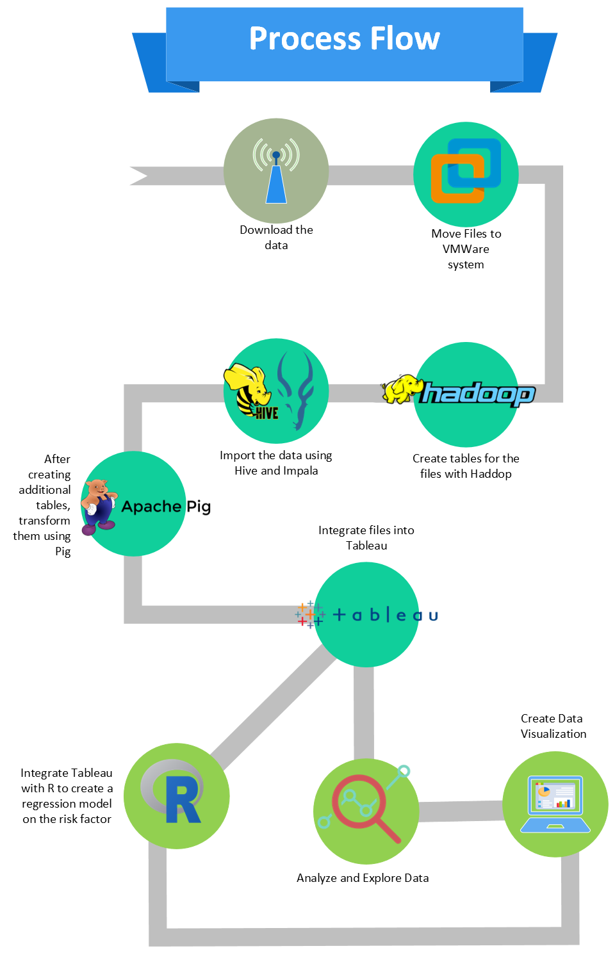
Process Flow

Slide 5
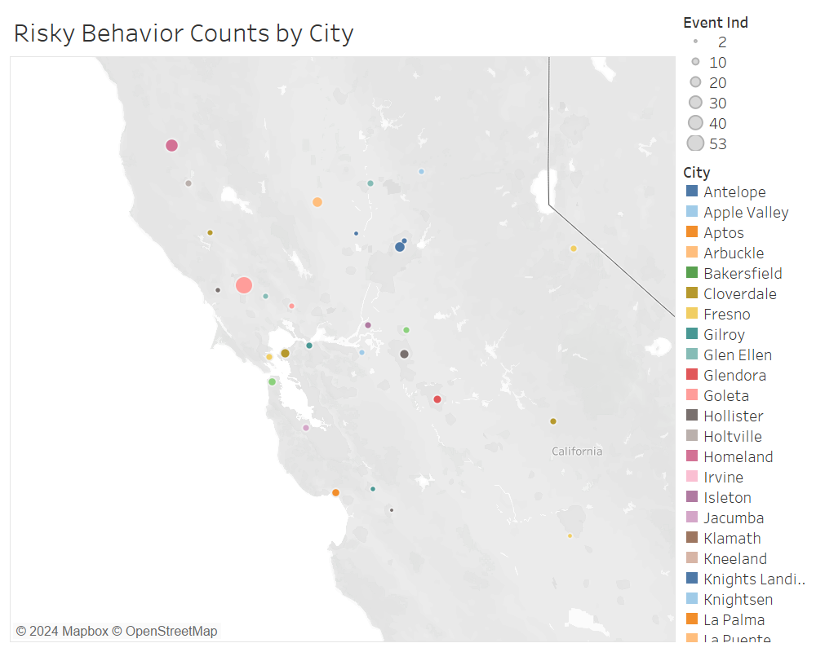
Population Trends Dashboard
Key Takeaways:
Santa Rosa, Willits and Apple Valley are the cities with the highest number of unsafe events
City trends should be studied to determine if the increased relationship is due to increased traffic, or other factors

Slide 6
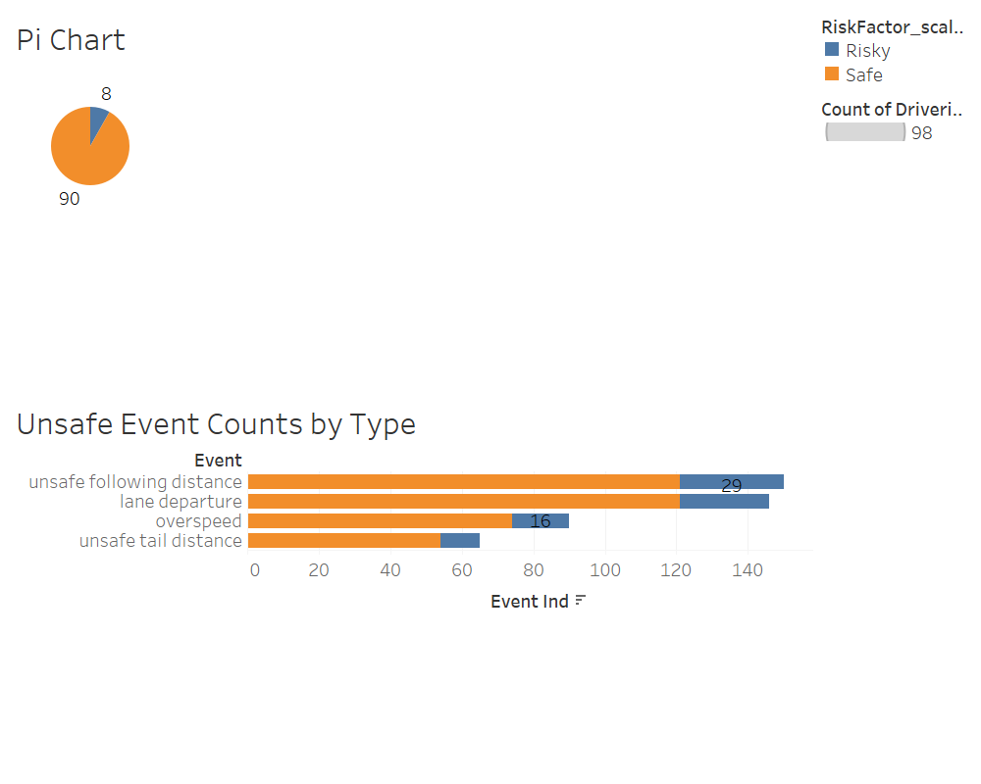
Risky to Safe Drivers
Key Takeaways:
Unsafe following distance is the most common unsafe behavior, closely followed by lane departures
Safety measures that assist with lane departures or unsafe following distances should be implemented

Slide 7
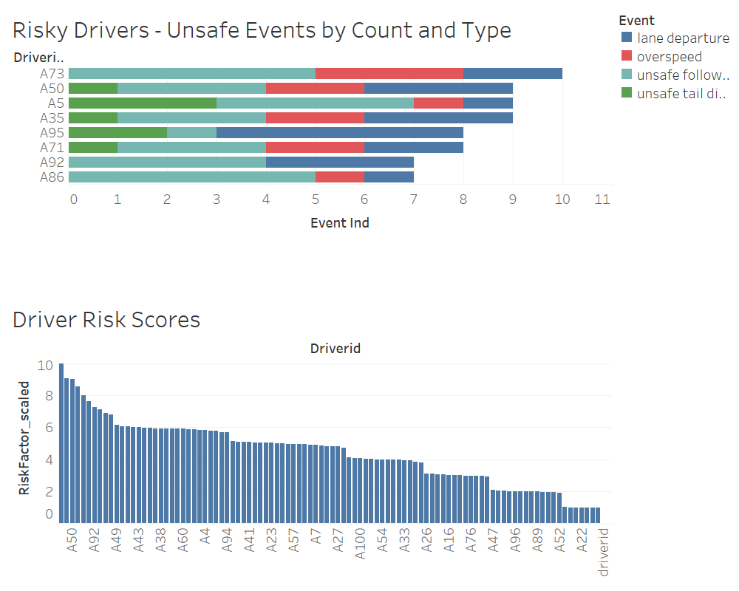
Risk Trends Dashboard
Key Takeaways:
Among unsafe drivers, the most common event is unsafe following distance.
Drivers with a score of 6 who exhibit high counts of unsafe following distance should be closely monitored before being classified as "risky"

Slide 8
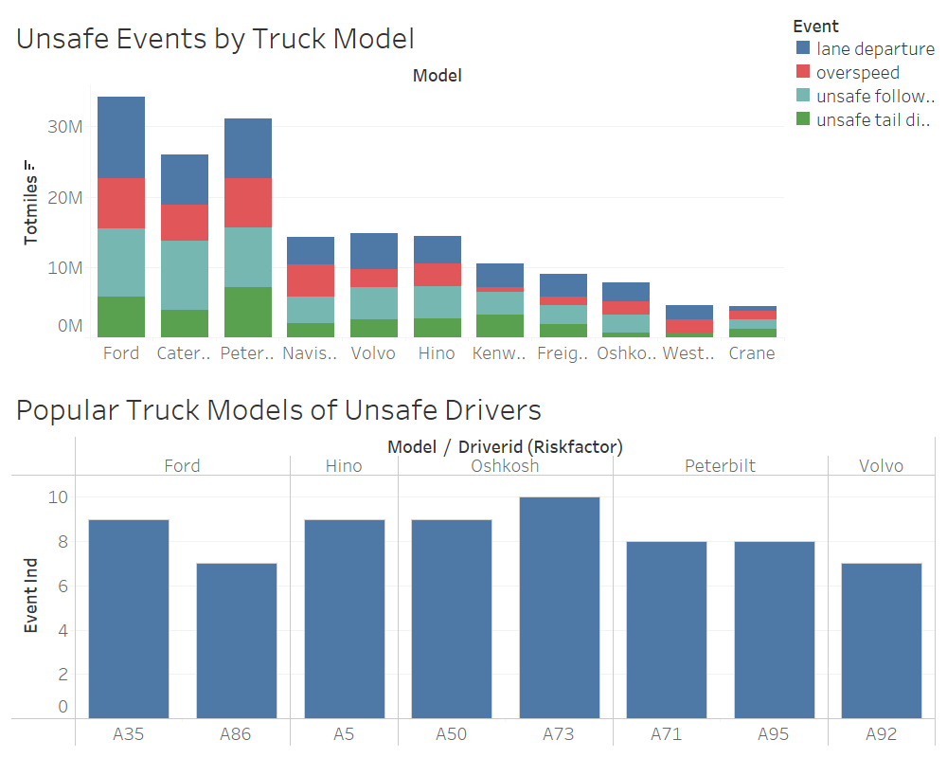
Additional Insights
Key Takeaways:
Among unsafe drivers, the most common truck models are Ford, Oshkosh and Peterbilt.
Based on total event trends, there are few discernable insights specific to truck models

Slide 9
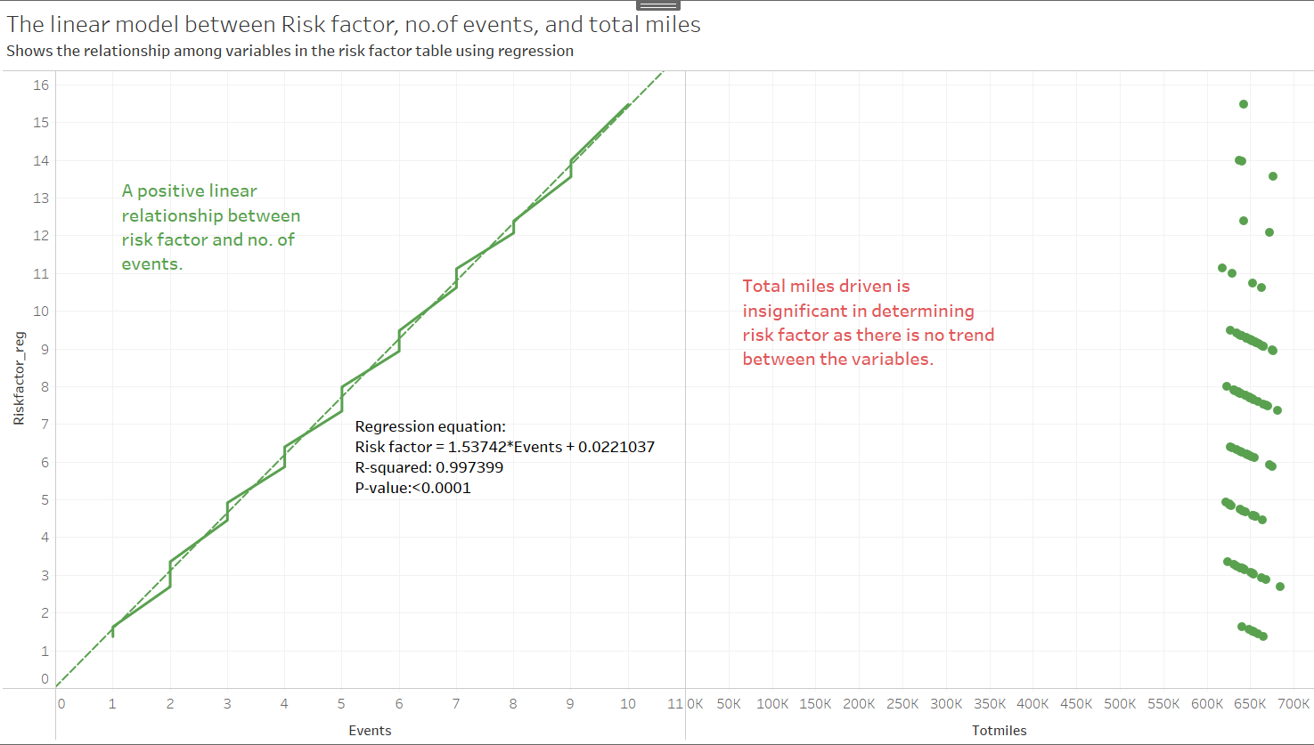
Regression Analysis

Slide 10



Challenges & Suggestions
Conclusion
Challenges
Suggestions:
Truck A97 has the highest average risk factor at 31.7, appearing frequently in 7 of the top 10 cities.
Santa Rosa, Willits and Apple Valley are the cities with highest risk.
Identifying risk factors such as lane departure, speeding, and unsafe following distance can help mitigate risks.
High-risk models like Ford, Peterbilt, Caterpillar, and Volvo show a correlation between increased mileage and risk, while Navistar has a high-risk factor despite lower mileage.
Low-risk models like Hino and Western Star are recommended for new acquisitions.
Slow network issue with Regression Analysis
Technical software issues, for example; Had trouble with Impala where the default folder in Impala was not showing up.
Scheduling
Limited Data Sample
No KPIs defined besides risk factor
Add additional data sets: driver profiles, city infrastructure
Develop a predictive model using Machine Learning
Obtain data for all 50 states instead of just one state to perform thorough analysis.
(With respect to analysis made) Have risky truck drivers like A97 take additional CDL driving safety courses.
(With respect to analysis made)Come up with additional regulations especially for sensor violations in cities like Santa Rosa.

Slide 11

QUESTIONS??

Slide 12
THANK YOU

